Slide 1
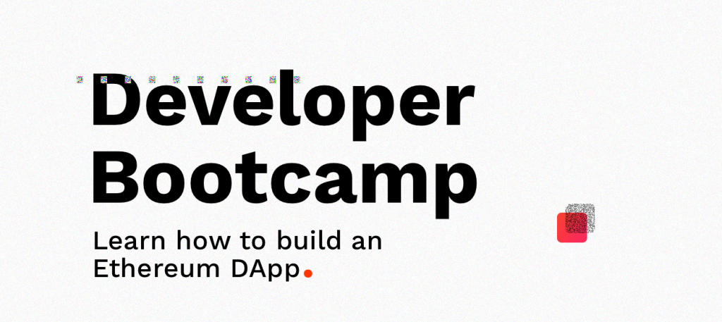

Slide 2

Intro to Ethereum Development
Eric Chung, DApperNetwork Founder
DAPPERNETWORK

Slide 3
What?
1

Slide 4
DApper.
Early blockchain tech adopter building decentralized apps (DApps)
WHAT

Slide 5
DApperNetwork.
Global community of early blockchain tech adopters building decentralized apps (DApps)
WHAT

Slide 6
Why?
2

Slide 7
Establish global network of resources that will accelerate the mainstream adoption of DApps
WHY

Slide 8
Purpose.
3

Slide 9
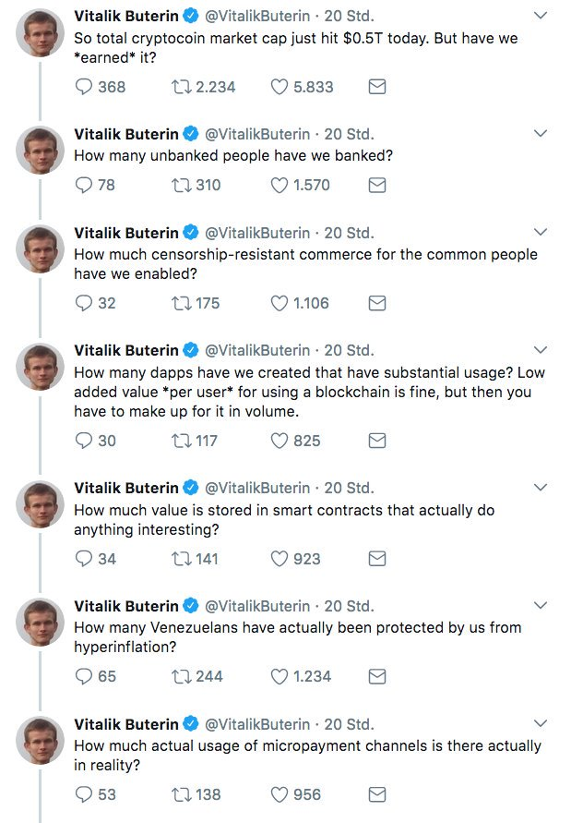

Slide 10
Still very early.
INGREDIENTS

Slide 11
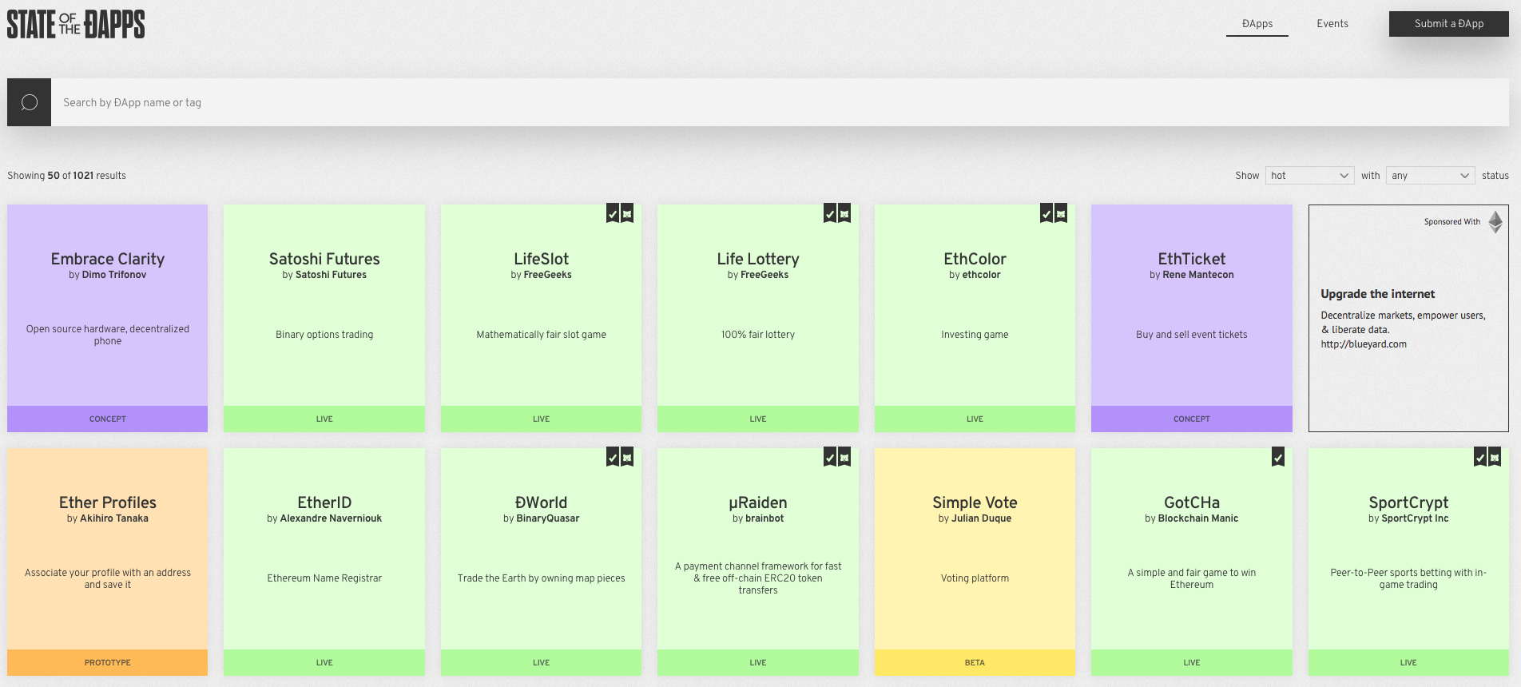

Slide 12
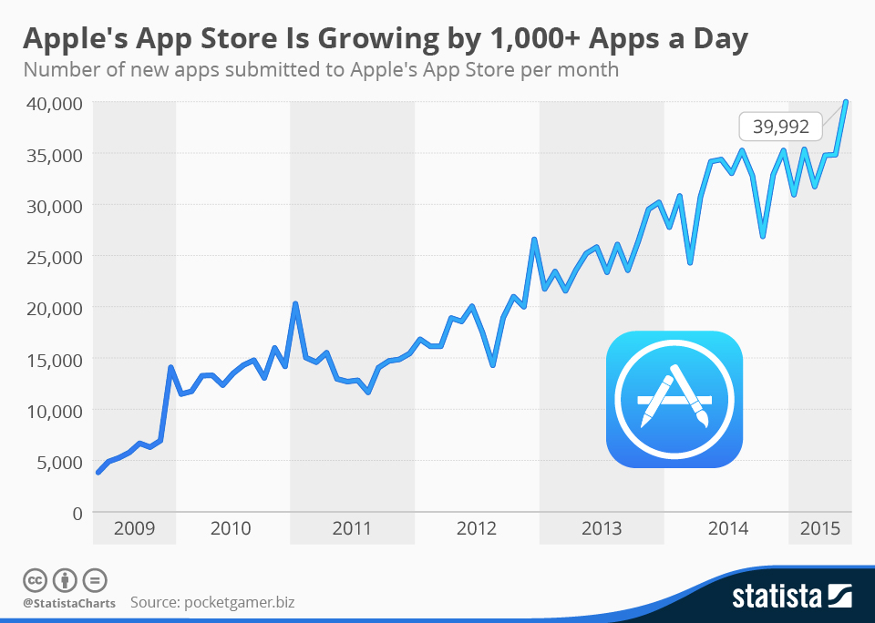

Slide 13
A lot of talk,
not a lot of walk.
INGREDIENTS

Slide 14
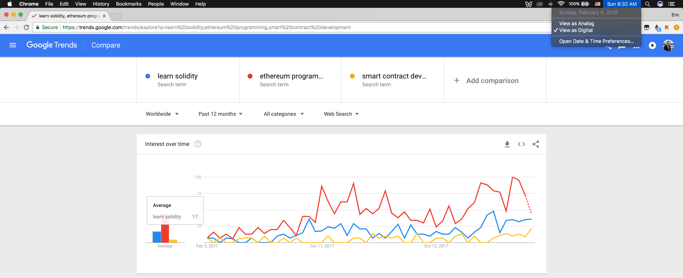

Slide 15
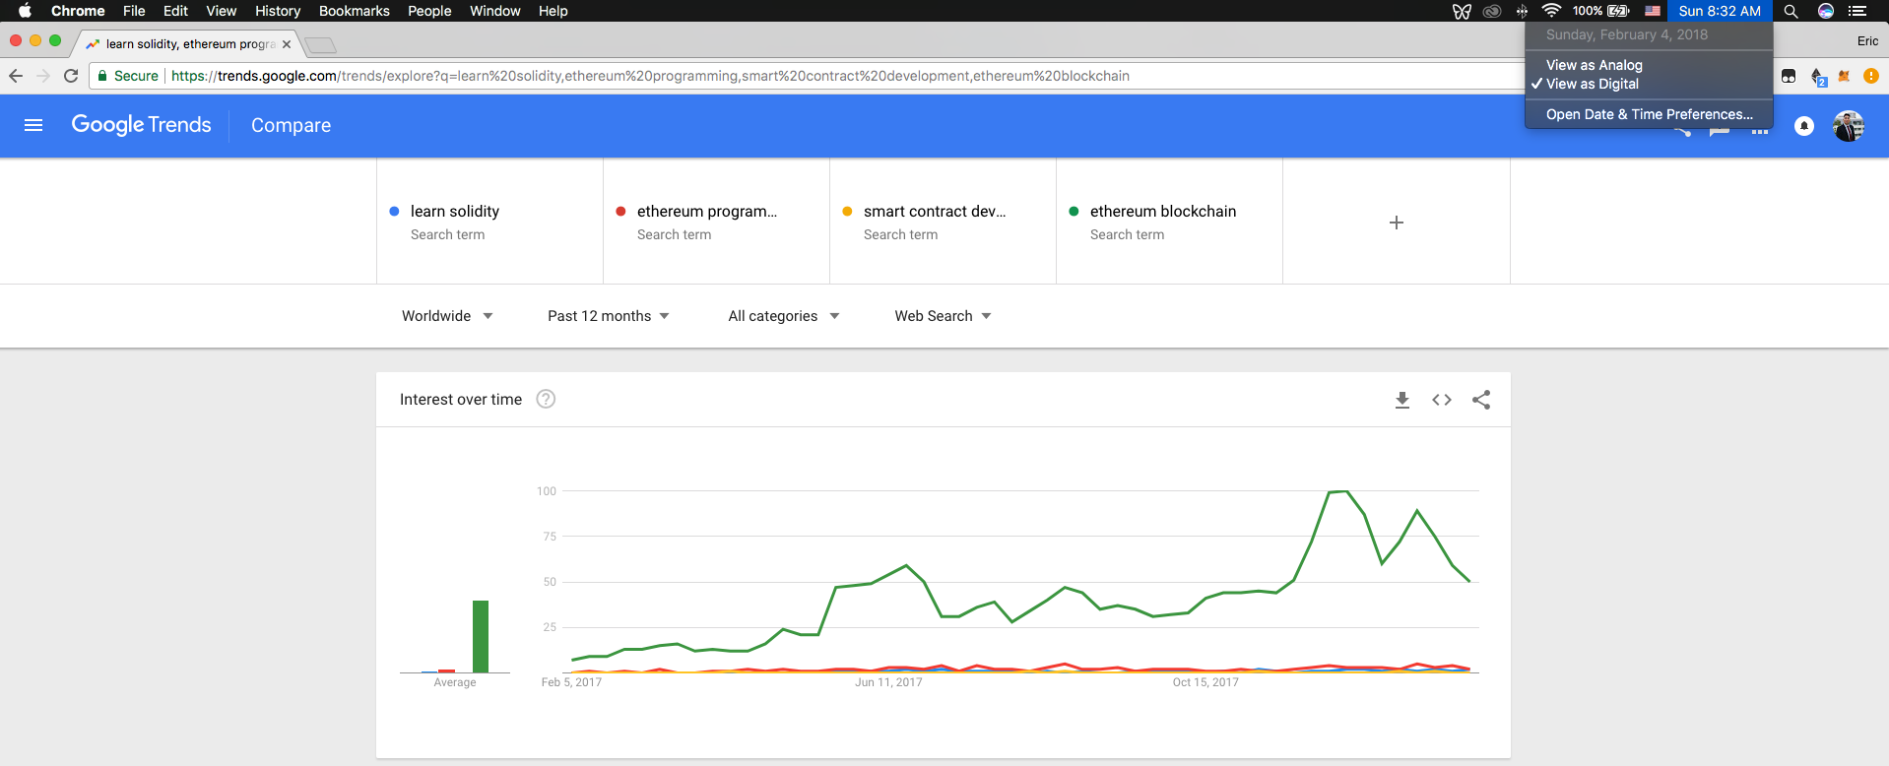

Slide 16
Simple economics.
INGREDIENTS

Slide 17
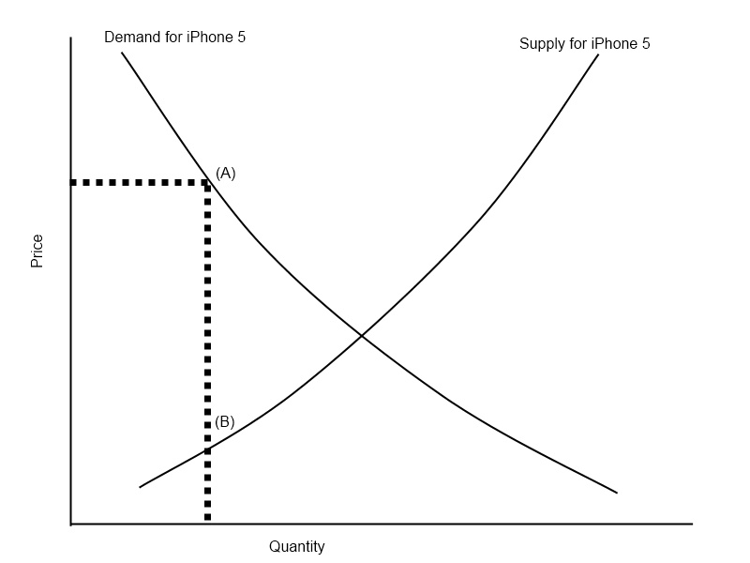
Ethereum developers
Ethereum developers

Slide 18
Ingredients.
4

Slide 19
The Blockchain.
Blocks
Hashes
Consensus
Trust
INGREDIENTS

Slide 20
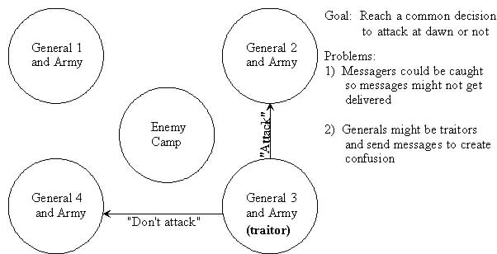

Slide 21
Smart Contracts.
Lineage includes Nick Szabo, colored coins
Distributed code vending machines
Turing-completeness
INGREDIENTS

Slide 22
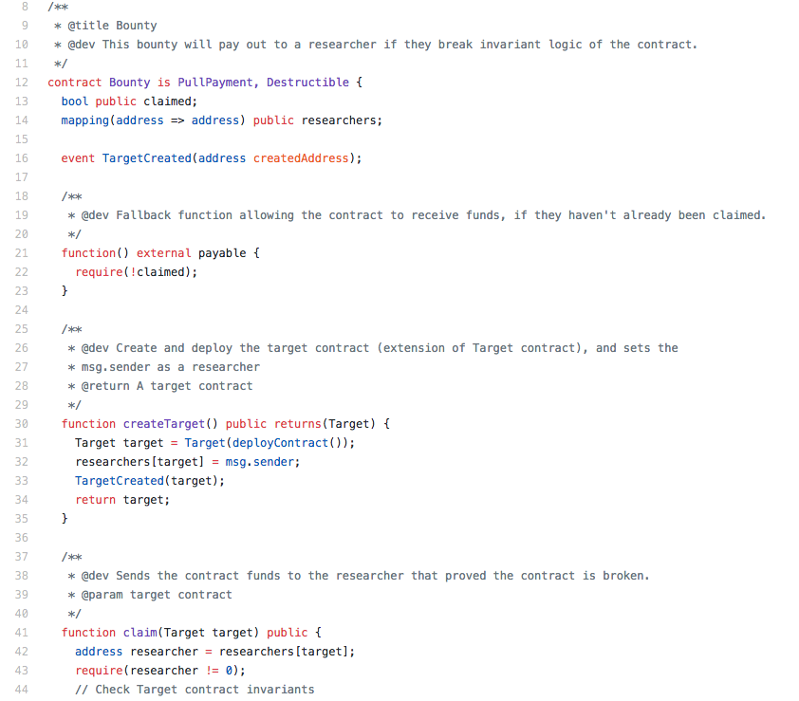

Slide 23
World Computer.
Ethereum Virtual Machine = decentralization
Every single node runs every bit of code to verify output
INGREDIENTS

Slide 24
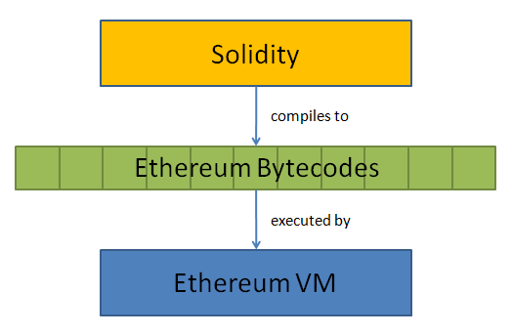

Slide 25
Gas.
Cost of computing resources required to perform an operation
Gas limit = ceiling for operation
Gas price = “pay attention to my transaction”
Gas fees feed miners
INGREDIENTS

Slide 26
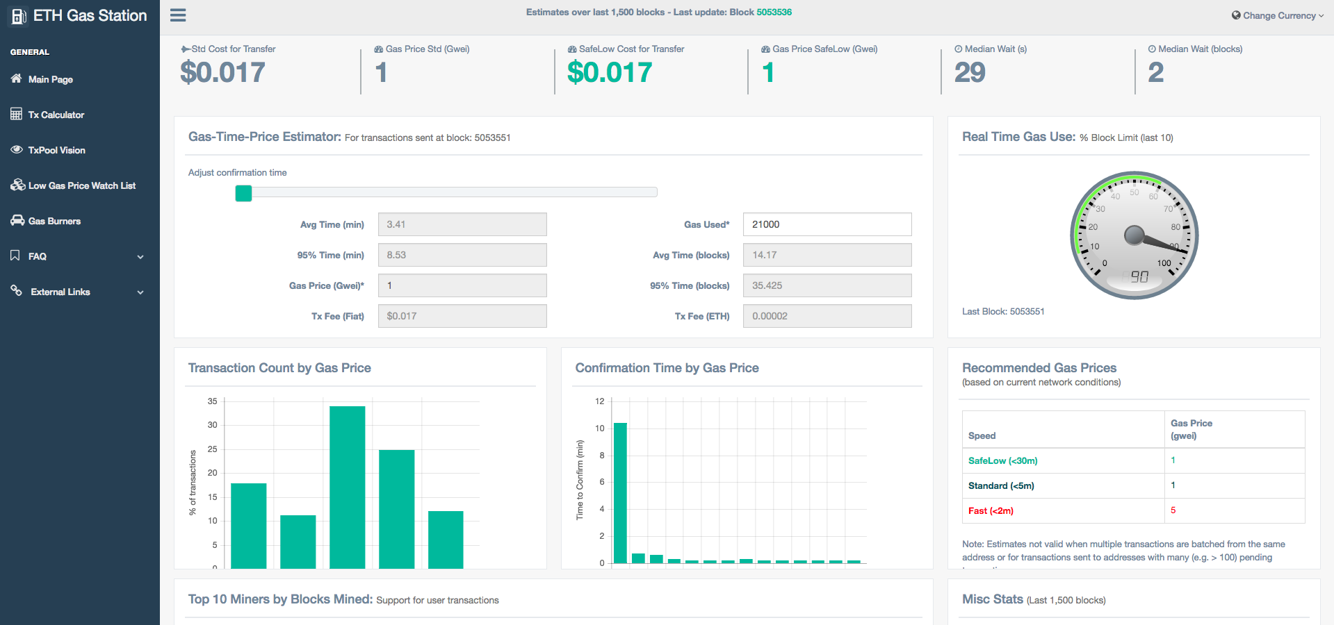

Slide 27
Gas.
Prevents infinite loops and intensive computations
Sloppy code is expensive and unacceptable
Security ALWAYS trumps optimization
INGREDIENTS

Slide 28


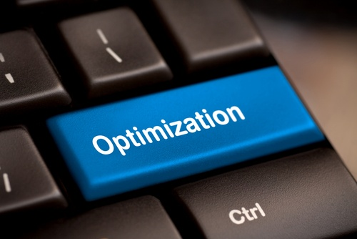

Slide 29
Deployment Tools.
Truffle: command line
Remix: browser
INGREDIENTS

Slide 30
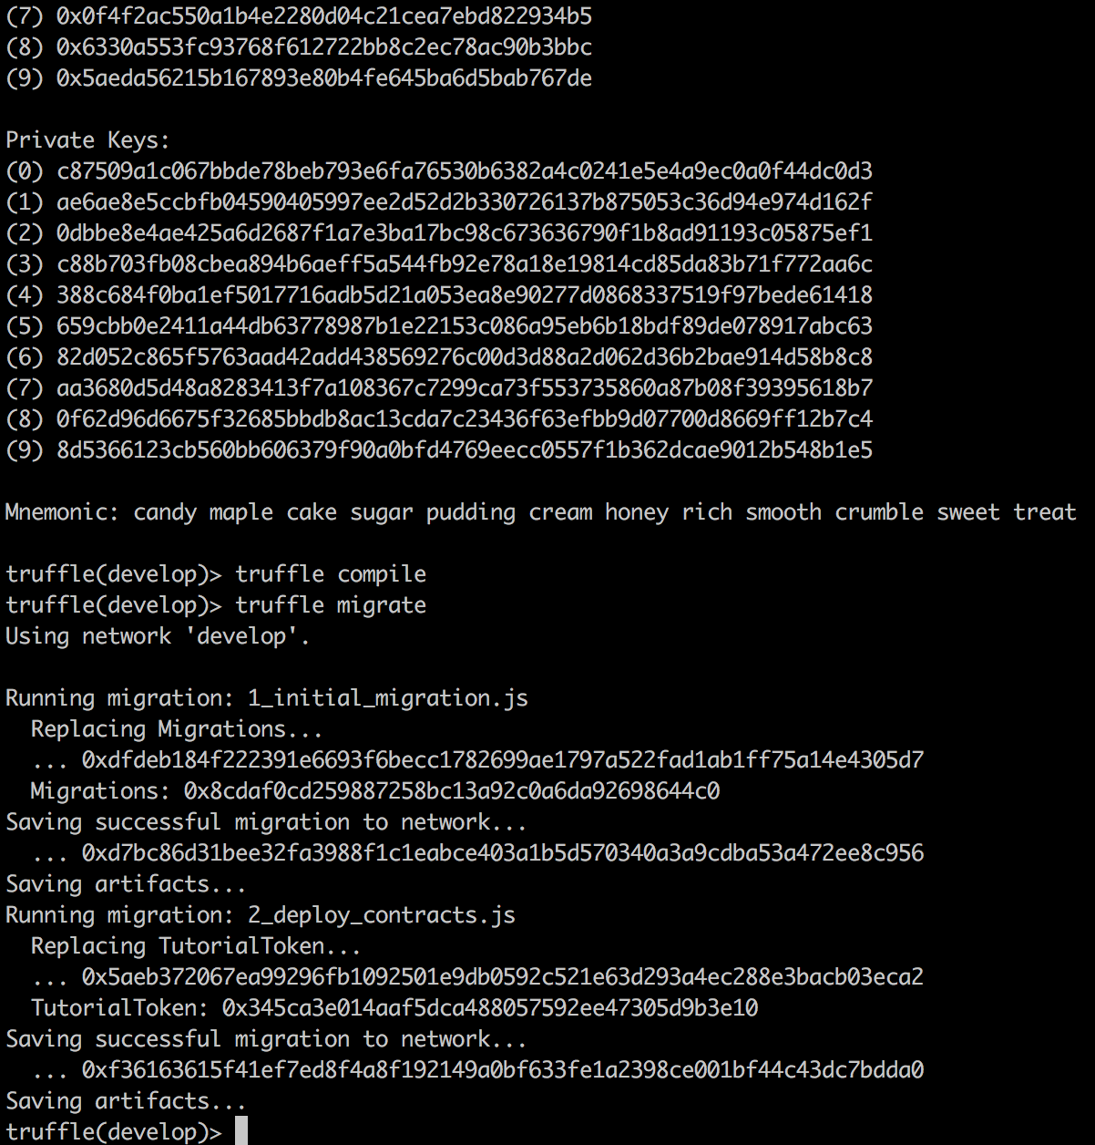
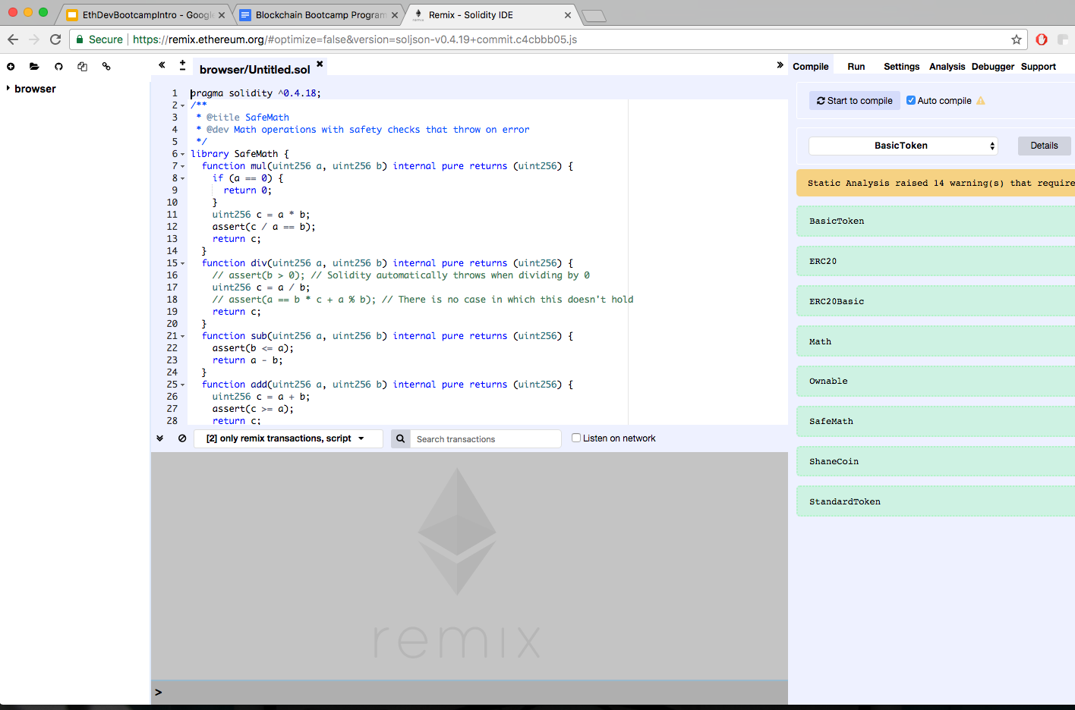

Slide 31
Smart Contract Tools.
Solidity: lingua franca
Web3js: mediator
INGREDIENTS

Slide 32
Ancillary Tools.
Metamask: Chrome extension wallet
Etherscan: block explorer
Ethstats: network stats
OpenZeppelin: contract templates
Infura: node clusters
INGREDIENTS

Slide 33
Other Blockchains.
EOS
Neo
Dfinity
INGREDIENTS

Slide 34
DApp.
Over 1k DApps on State of the DApps
Prediction markets, DEX, social networks, curated lists, and more
INGREDIENTS

Slide 35
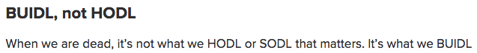

Slide 36
Themes.
5

Slide 37
Immutability.
Code that is deployed on the blockchain is there FOREVER
No surprises vs no (direct) patching
THEMES

Slide 38
Security.
Move slow, don’t break anything
Risk mitigation
THEMES

Slide 39
Transparency.
Honest accountability
Transactions, code, addresses
THEMES

Slide 40
Token Economics.
Incentives to guide human behavior
Value exchange
THEMES

Slide 41
User Experience.
Command line? No thanks
Private key management
Better design
THEMES

Slide 42
Scalability.
Significant bottleneck
Plasma, Raiden, sharding, state channels
THEMES

Slide 43
Thanks yall!
Eric Chung, DApperNetwork Founder
DAPPERNETWORK

